Slide 1
Project Modelling and Evaluation
Objectives:
(A)How successful the credit card campaign leads to customers signing up credit card
(B)How successful the credit card promotion leads to increase in customers’ spending

Slide 2
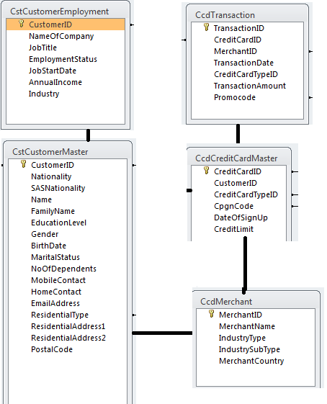
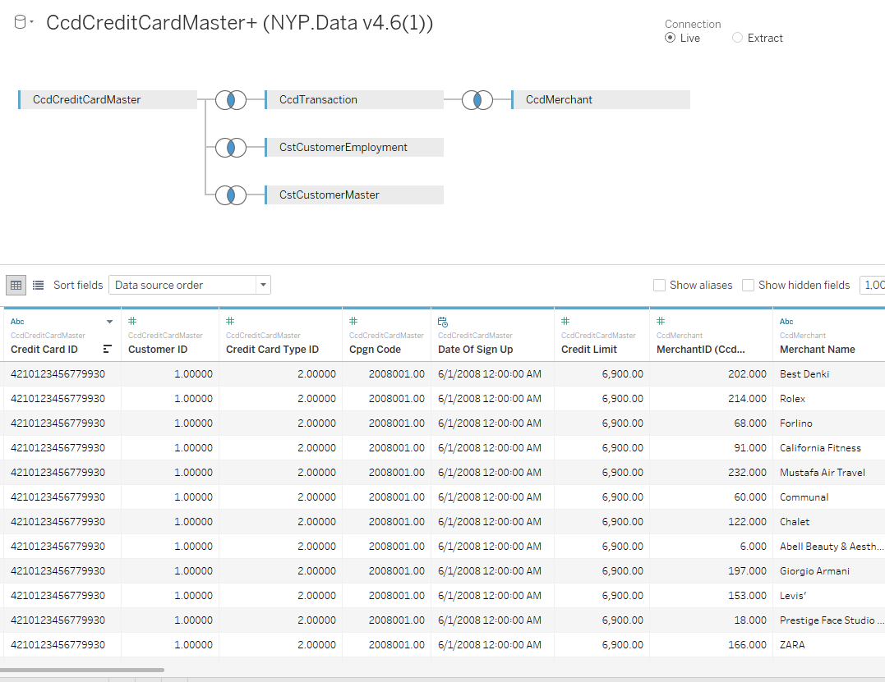
Objective 1: Data preparation
NUMERICAL | CATEGORICAL | CALCULATED FIELDS | BINS/GROUPS
CustomerID | Education Level | Customers Age(years) | Age Group
No of Dependents | Gender | CreditCard Exists(yes/no) | Income Group
Postalcode | Marital Status | Birth month(month)
CampaignCode | Industry
CreditCardID | Job Title
CreditCardTypeID | CreditCard
Customers Age(years) | CreditCard Exists(yes/no)
Birth month(month)
TransactionID
MerchantID
TransactionAmount
Promocode

Slide 3
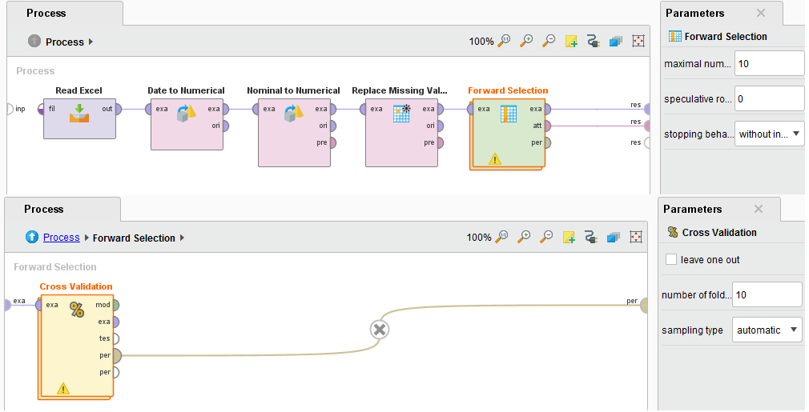
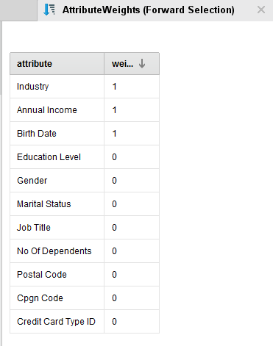
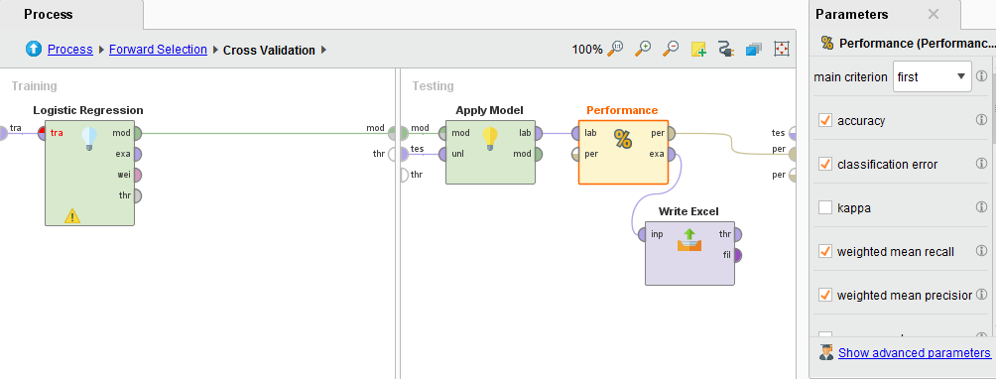
Objective 1: Data preparation
Using Forward Selection operator in Rapidminer to select relevant attributes for analysis. Model is shown below.

Slide 4
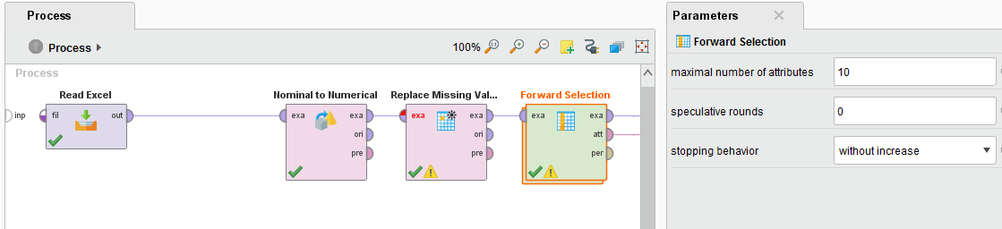
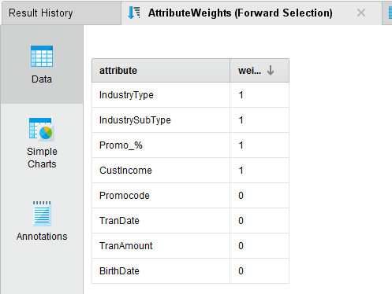
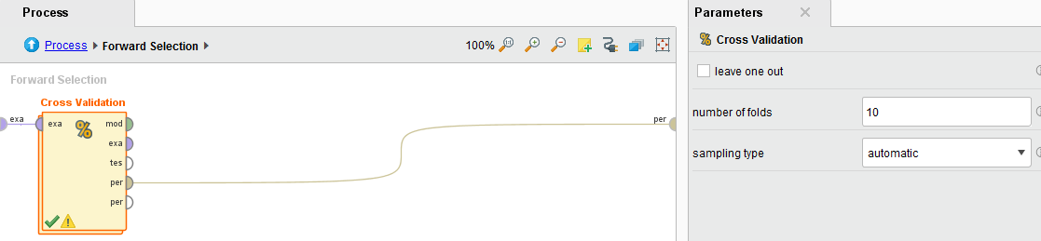
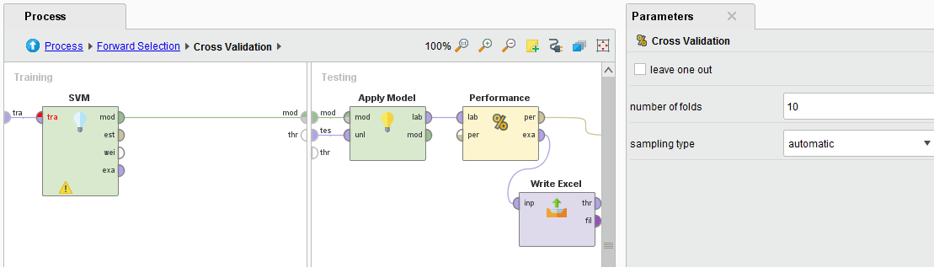
Objective 2: Data preparation-Part1
Forward selection operator to select best contributing attributes

Slide 5
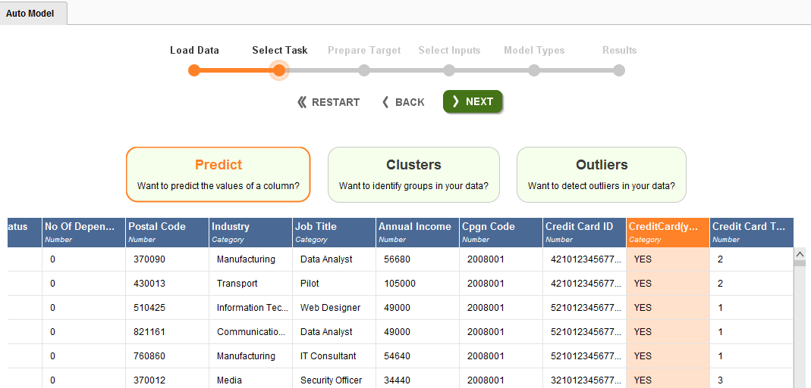
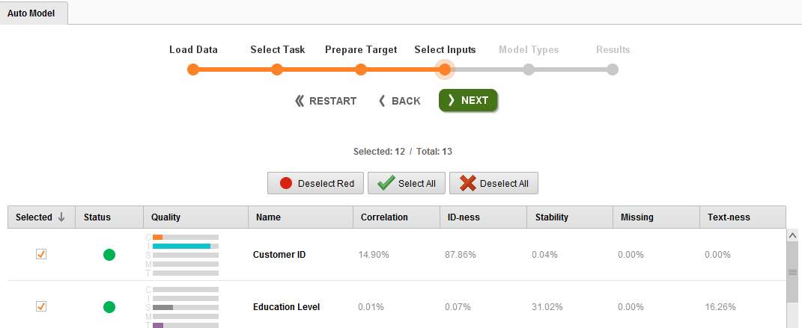
Automodel Study-Objective 1
For the model designing, Automodel tool in Rapidminer is used to find best designed model, comparing the performance of listed Models as shown below.

Slide 6
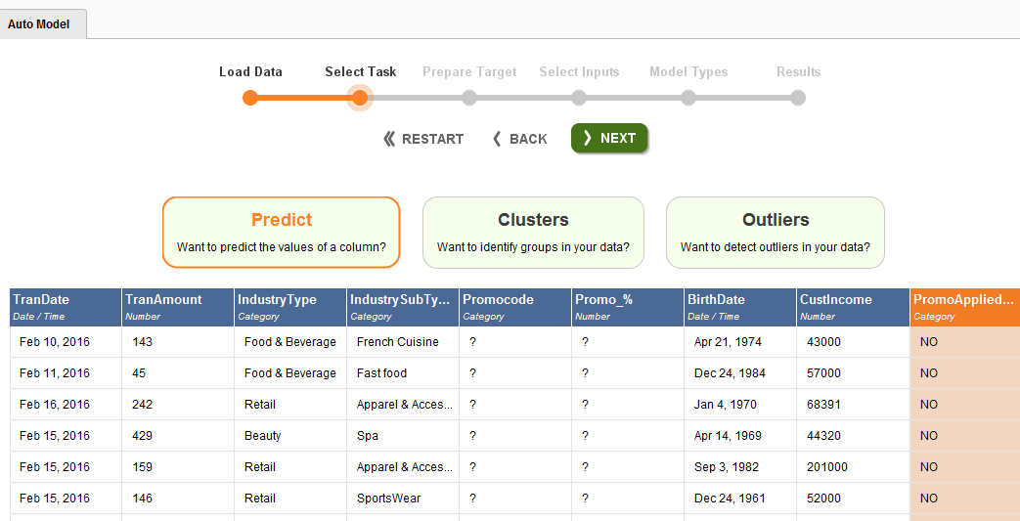
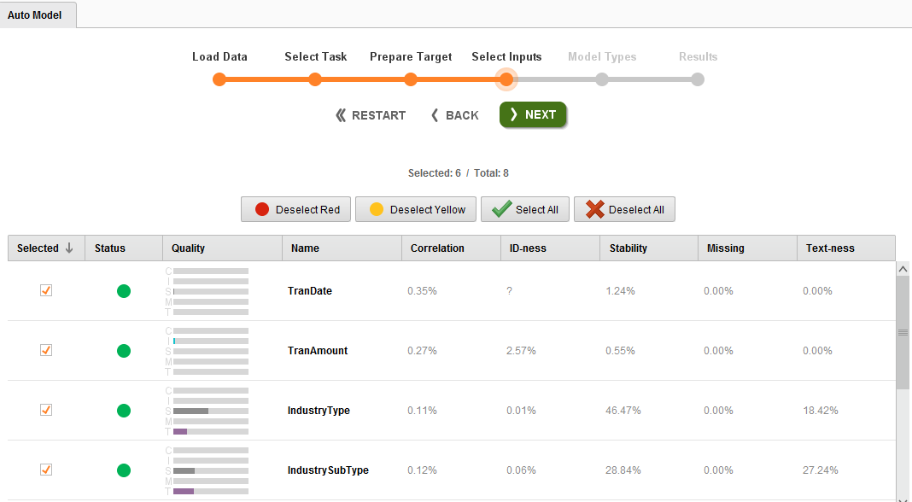
Automodel Study-Objective 2
For the model designing, Automodel tool in Rapidminer is used to find best designed model, comparing the performance of listed Models as shown below.

Slide 7
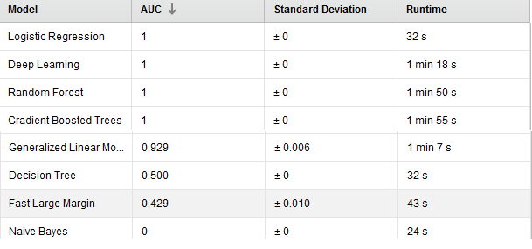
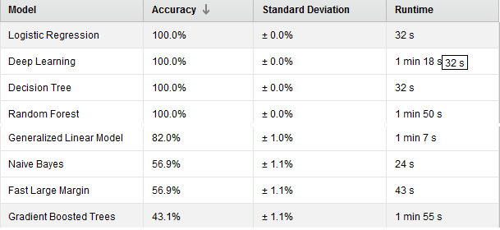
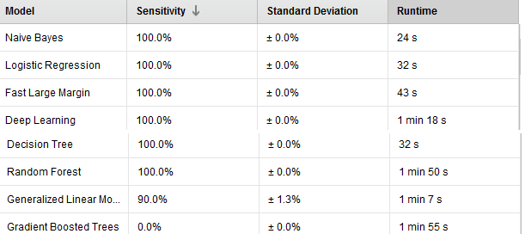
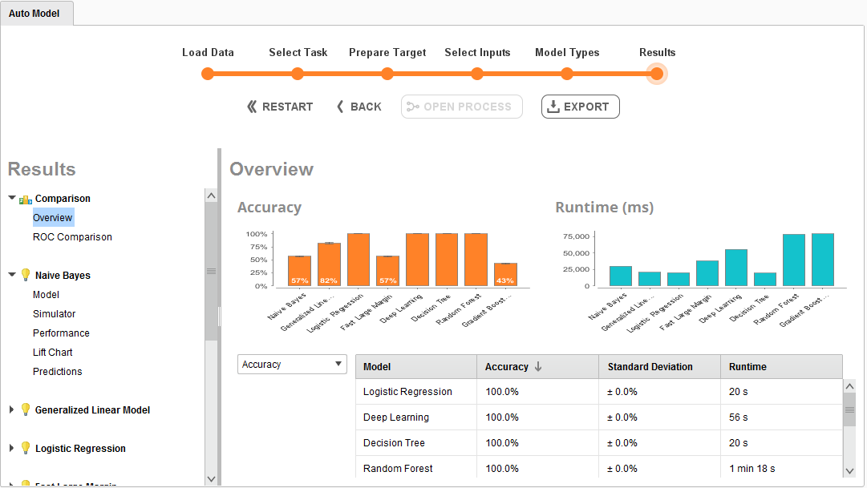
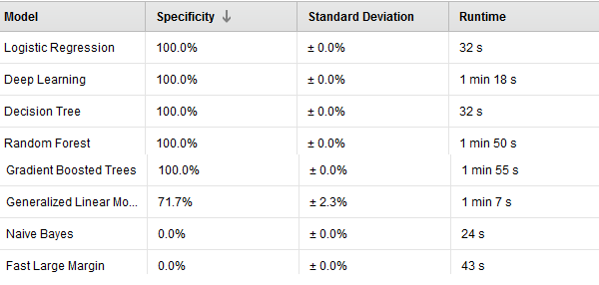
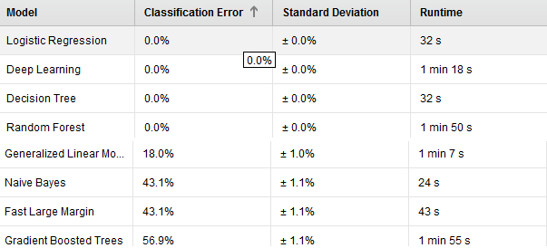
Automodel Summary-Objective 1
AUC
Accuracy
Sensitivity
Specificity
Classification Error

Slide 8
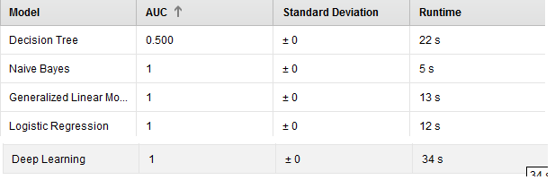
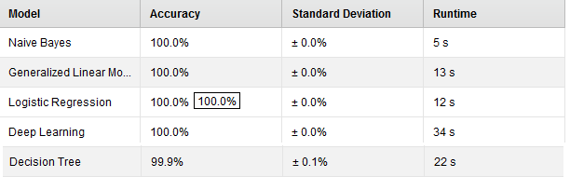
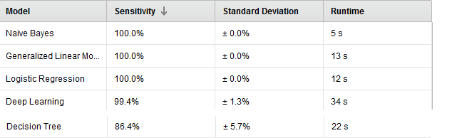
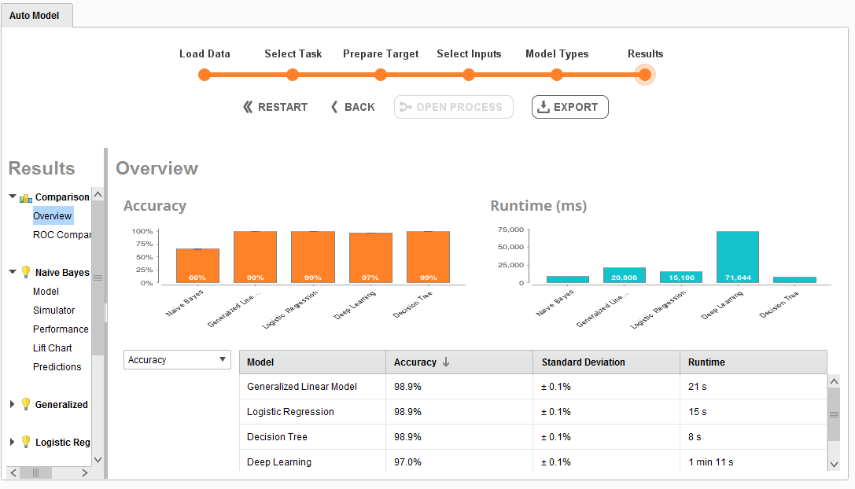
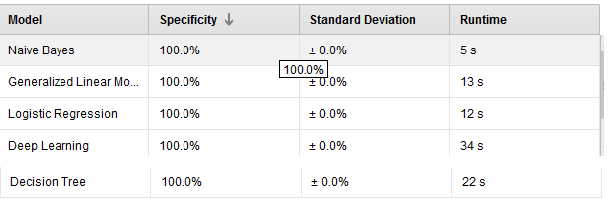
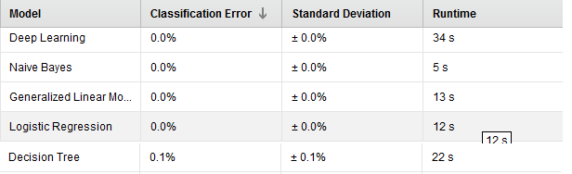
Automodel Summary-objective 2
AUC
Accuracy
Sensitivity
Specificity
Classification Error

Slide 9
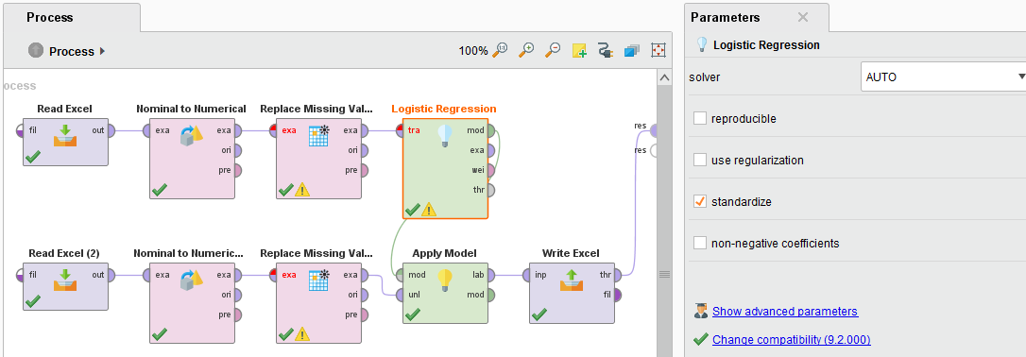
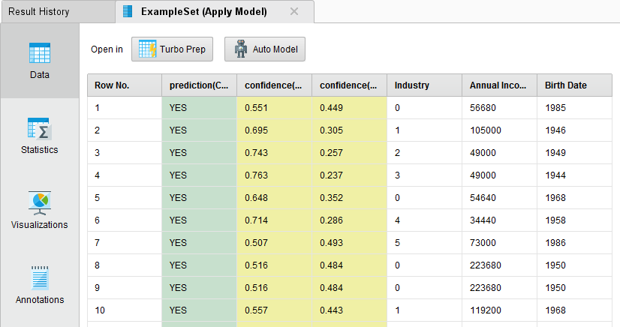
Classification Model 1
Logistic Regression model is designed to predict, possible creditcard sign up for the short listed relevant Customer Demographic attributes from earlier steps.

Slide 10
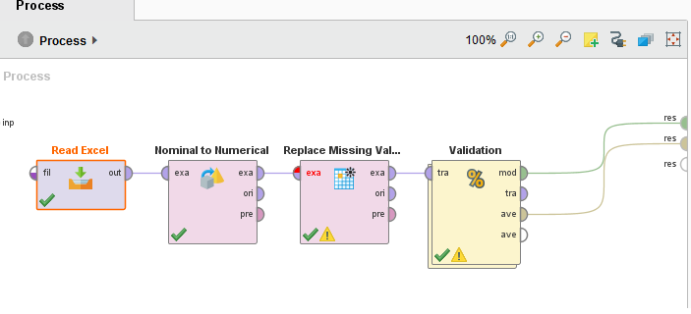
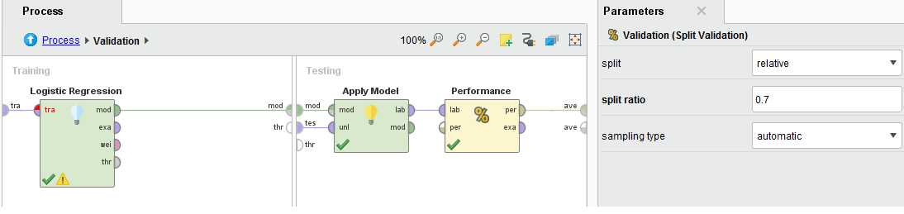
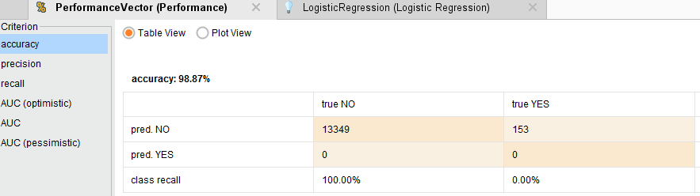
Logistic regression validation

Slide 11
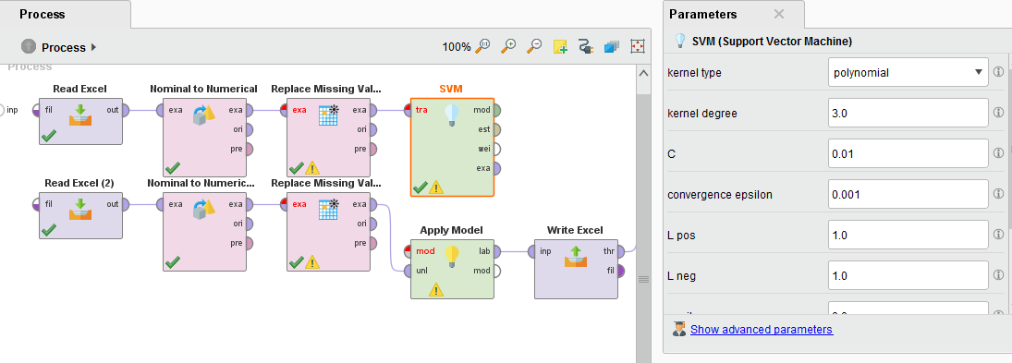
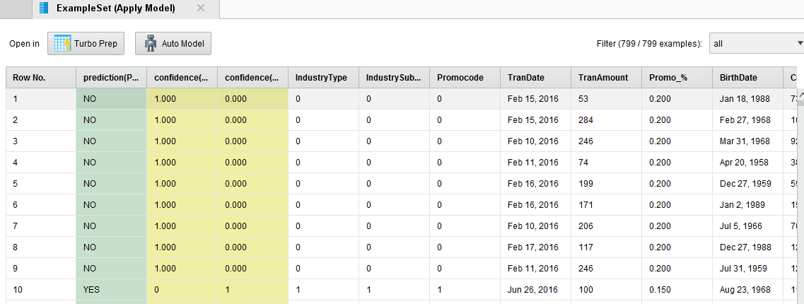
Support vector machine – objective 2

Slide 12
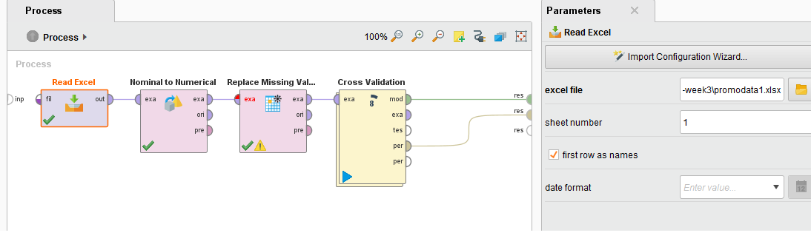
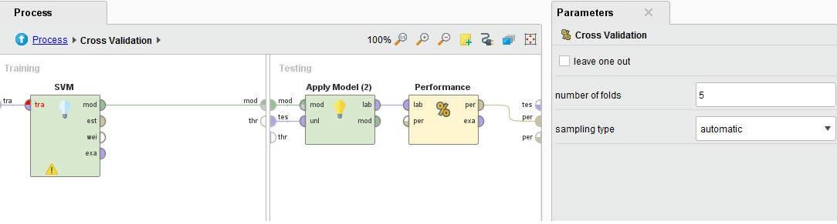
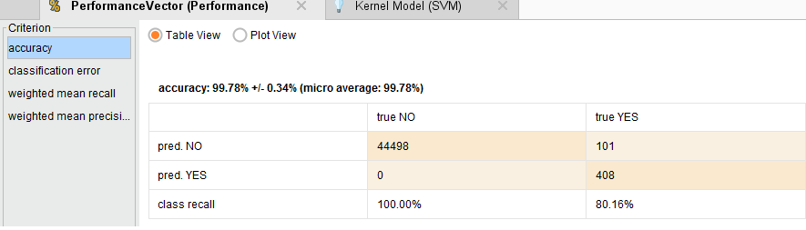
Support Vector Machine X-Validation

Slide 13
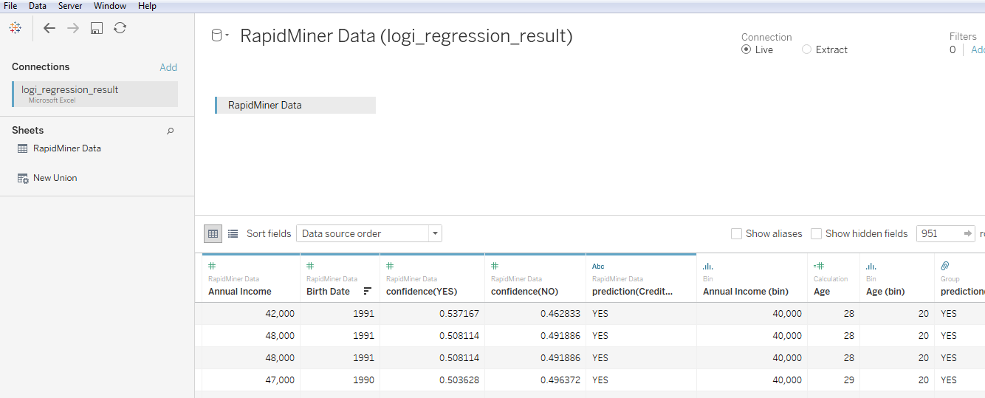
Data Visualization of Predicted results /customer demographics/
Tableau Data:
The result obtained from the Logistic Regression is used to get visualization chart and evaluates the results obtained based on customer demographics

Slide 14
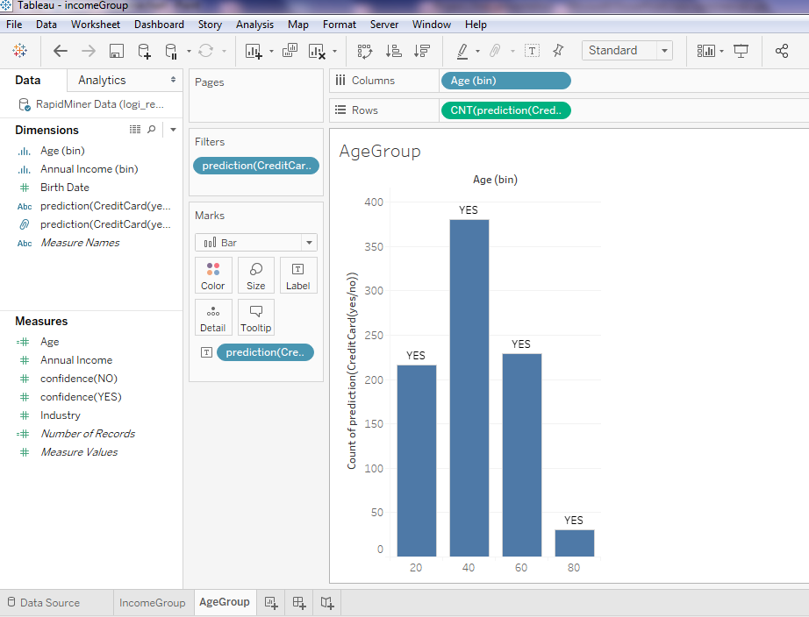
Customer Age Group
Customers who belongs to Age group between 40 and 60 YEARS OLD are more likely to sign up for the creditcard

Slide 15
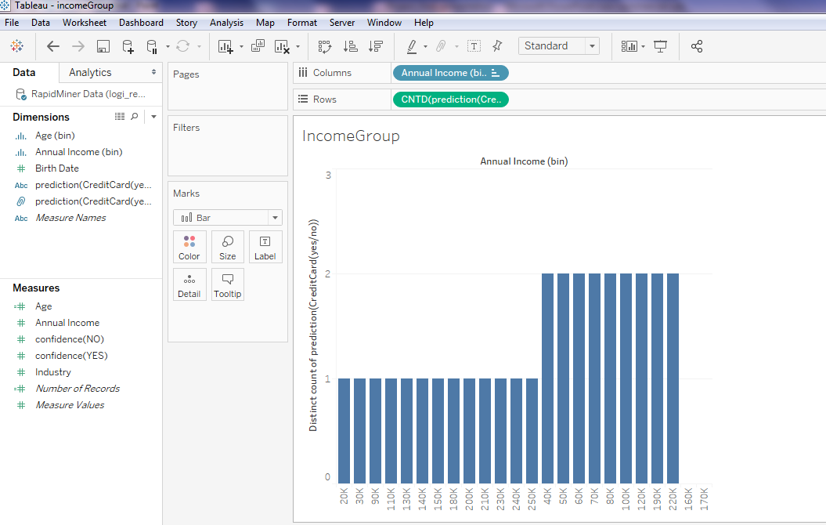
Income Group
Customers whose earnings in Income group between 40K to 220K are more likely to be sign up for the creditcard

Slide 16
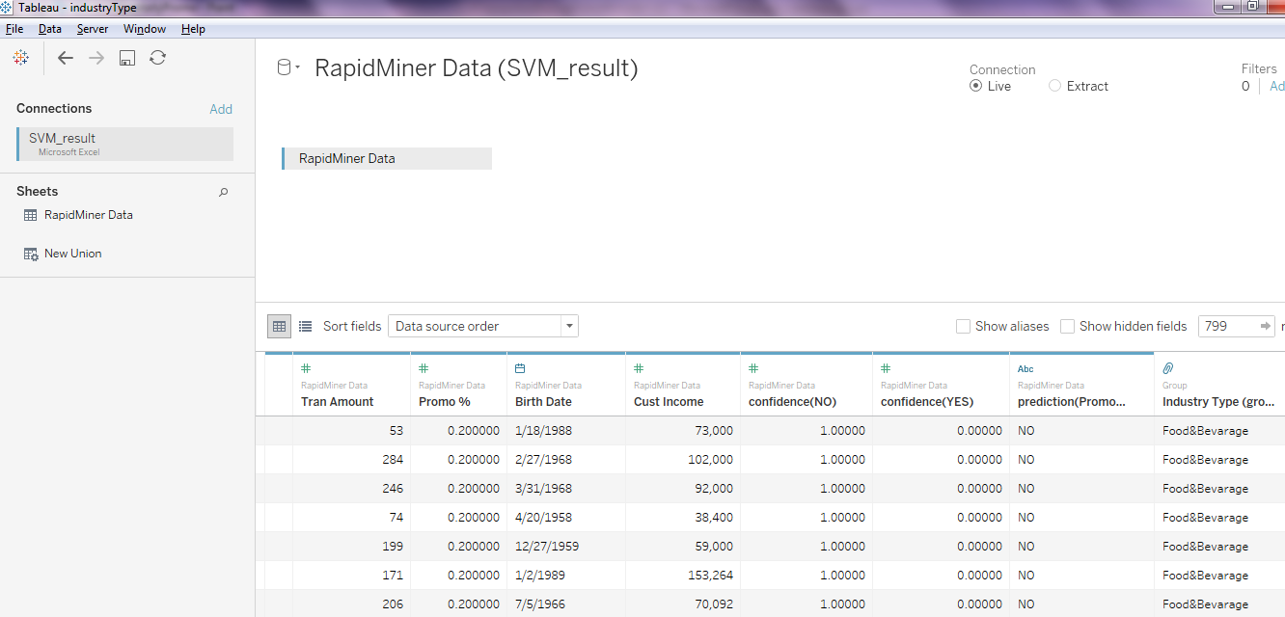
Data Visualization of Predicted results /Customer Spending Nature/
Tableau Data:
The result obtained from the SVM model is used to get visualization chart and evaluates the results obtained based on customer spending nature

Slide 17
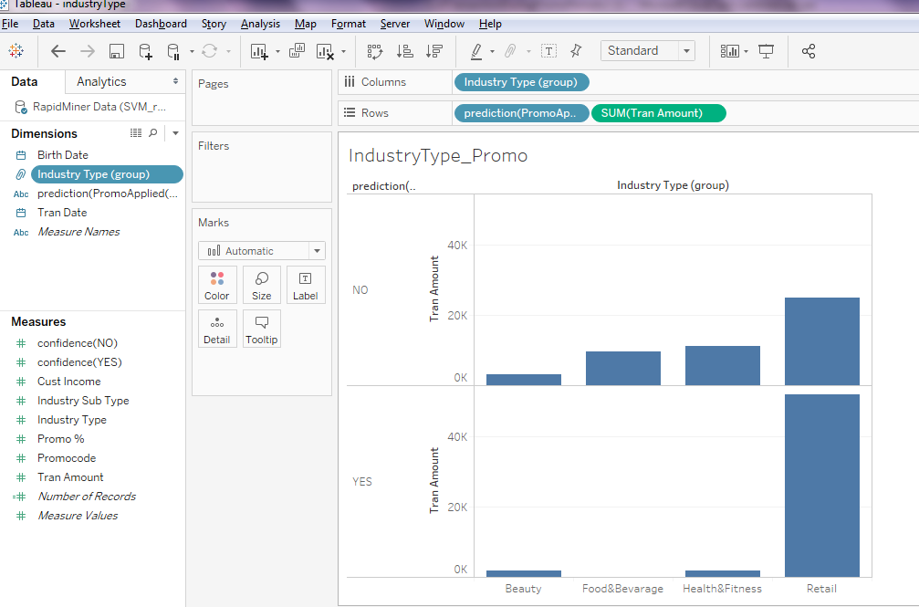
Industry type
Transaction amount using promocode are high in RETAIL industries

Slide 18
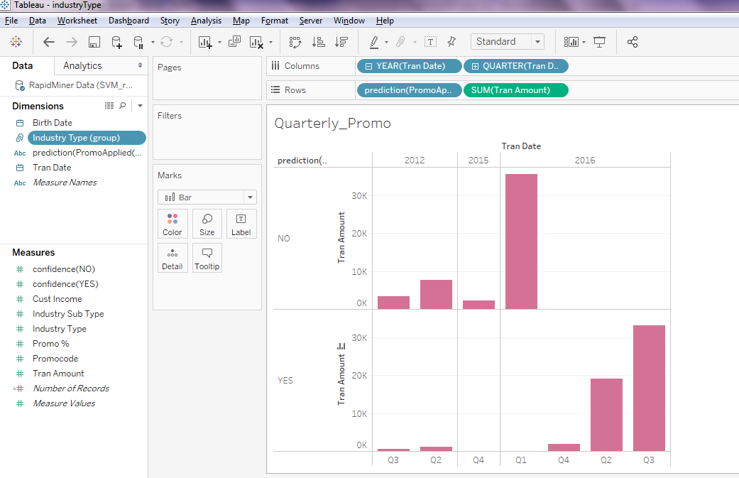
Quarterly Promotional spending
Customer spending is more during the THIRD AND SECOND QUARTERS OF THE YEAR with Promocode applied

